Slide 1


Predictive Maintenance Report
Presented by: Group 2

Slide 2

Introduction
In the ever-evolving energy sector, ensuring the uninterrupted operation of critical equipment such as turbines and generators is crucial for maximizing operational efficiency and minimizing downtime. Predictive maintenance, driven by advanced analytics and machine learning, offers a proactive approach to address the challenges associated with equipment failures.
To minimize downtime and cut down on maintenance costs associated with critical assets like turbines and generators, Enel Energy is committed to adopting cutting-edge technologies to enhance operational efficiency and reliability

Slide 3
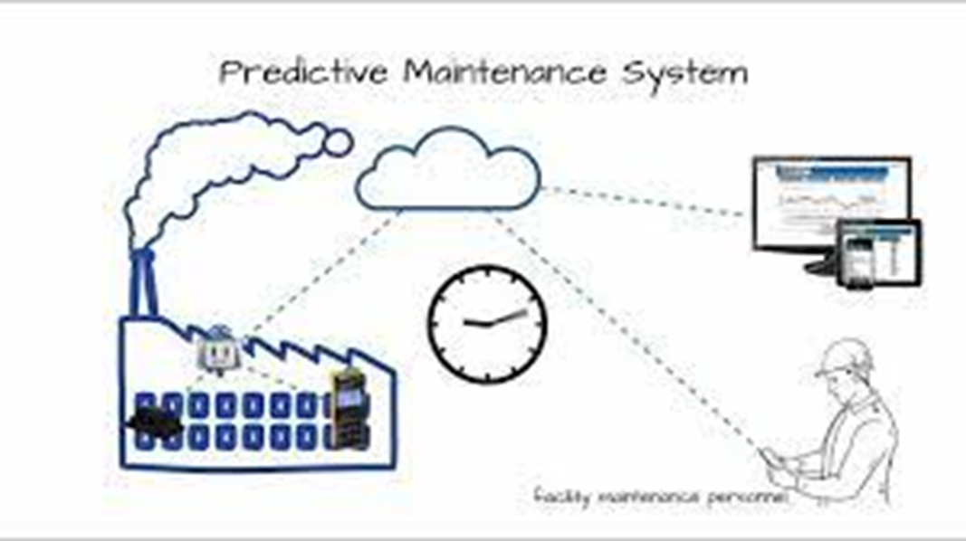
Problem Statement
The energy sector faces challenges related to the unpredictability of equipment failures, leading to unexpected downtime and significant maintenance expenses. Reactive maintenance practices result in operational disruptions and increased costs. There is a critical need for a proactive and data-driven approach to predict potential equipment failures, enabling timely interventions and cost-effective maintenance strategies.

Slide 4
Objectives
Enhance Operational Resilience: Acquire and refine turbine and generator sensor data to ensure its authenticity and relevance to real-world operating scenarios.
Optimize Data Quality: Implement robust data cleaning and preprocessing techniques to fortify the dataset's reliability, ensuring accurate insights for strategic decision-making.
Strategic Insights through Analysis: Leverage Exploratory Data Analysis (EDA) to extract actionable insights from equipment performance data, providing a foundation for informed decision-making.
Proactive Maintenance Implementation: Develop and deploy machine learning models to predict potential equipment failures, empowering the implementation of proactive maintenance strategies.
Performance Validation: Rigorously evaluate the predictive maintenance model's performance, aligning it with business objectives to ensure precision and cost-effectiveness in maintenance planning.
Seamless Integration for Impact: Integrate the predictive maintenance model seamlessly into operational workflows, strategically minimizing downtime and optimizing resource allocation for tangible business benefits.

Slide 5
How to address equipment failures
Prepare the dataset
Clean the data
Check for missing values and Outliers
Normalize
Preprocess
EDA
Visualizations
Extract insights for decision making
Machine Learning
Predict potential failures
Select for best accuracy

Slide 6
Data Dictionary
Timestamp: Date and time of the sensor data readings.
Sensor1, Sensor2, Sensor3: Various sensor readings from the equipment.
Temperature: Temperature readings from the equipment.
Pressure: Pressure measurements associated with the equipment's operation.
Vibration: Vibration levels recorded during equipment operation.
Failure Indicator (Target): Binary indicator (0 or 1) representing whether a failure occurred (1) or not (0) during a specific time period.

Slide 7
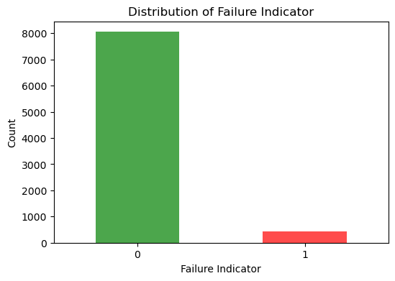
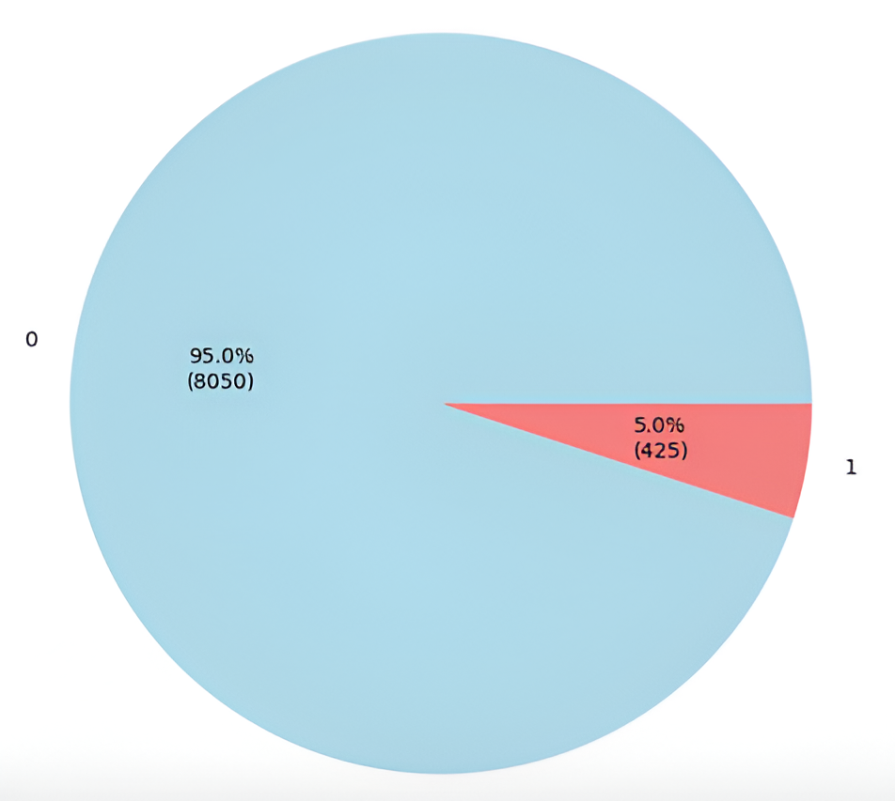
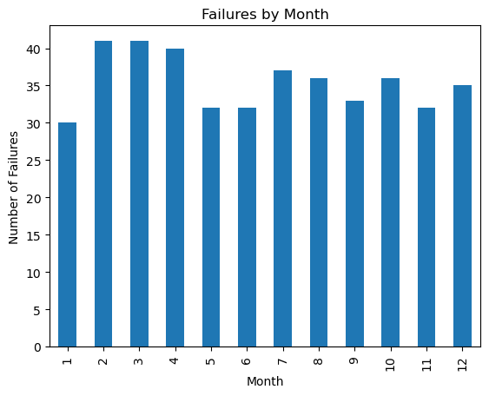
Exploratory Data Analysis
Observations
Analyzing these charts reveals that there were 425 failures over a one-year period, which is an average of 1.16 failures per day and 12.3 failures per month; resulting in financial losses and operational downtime for Enel Energies.

Slide 8
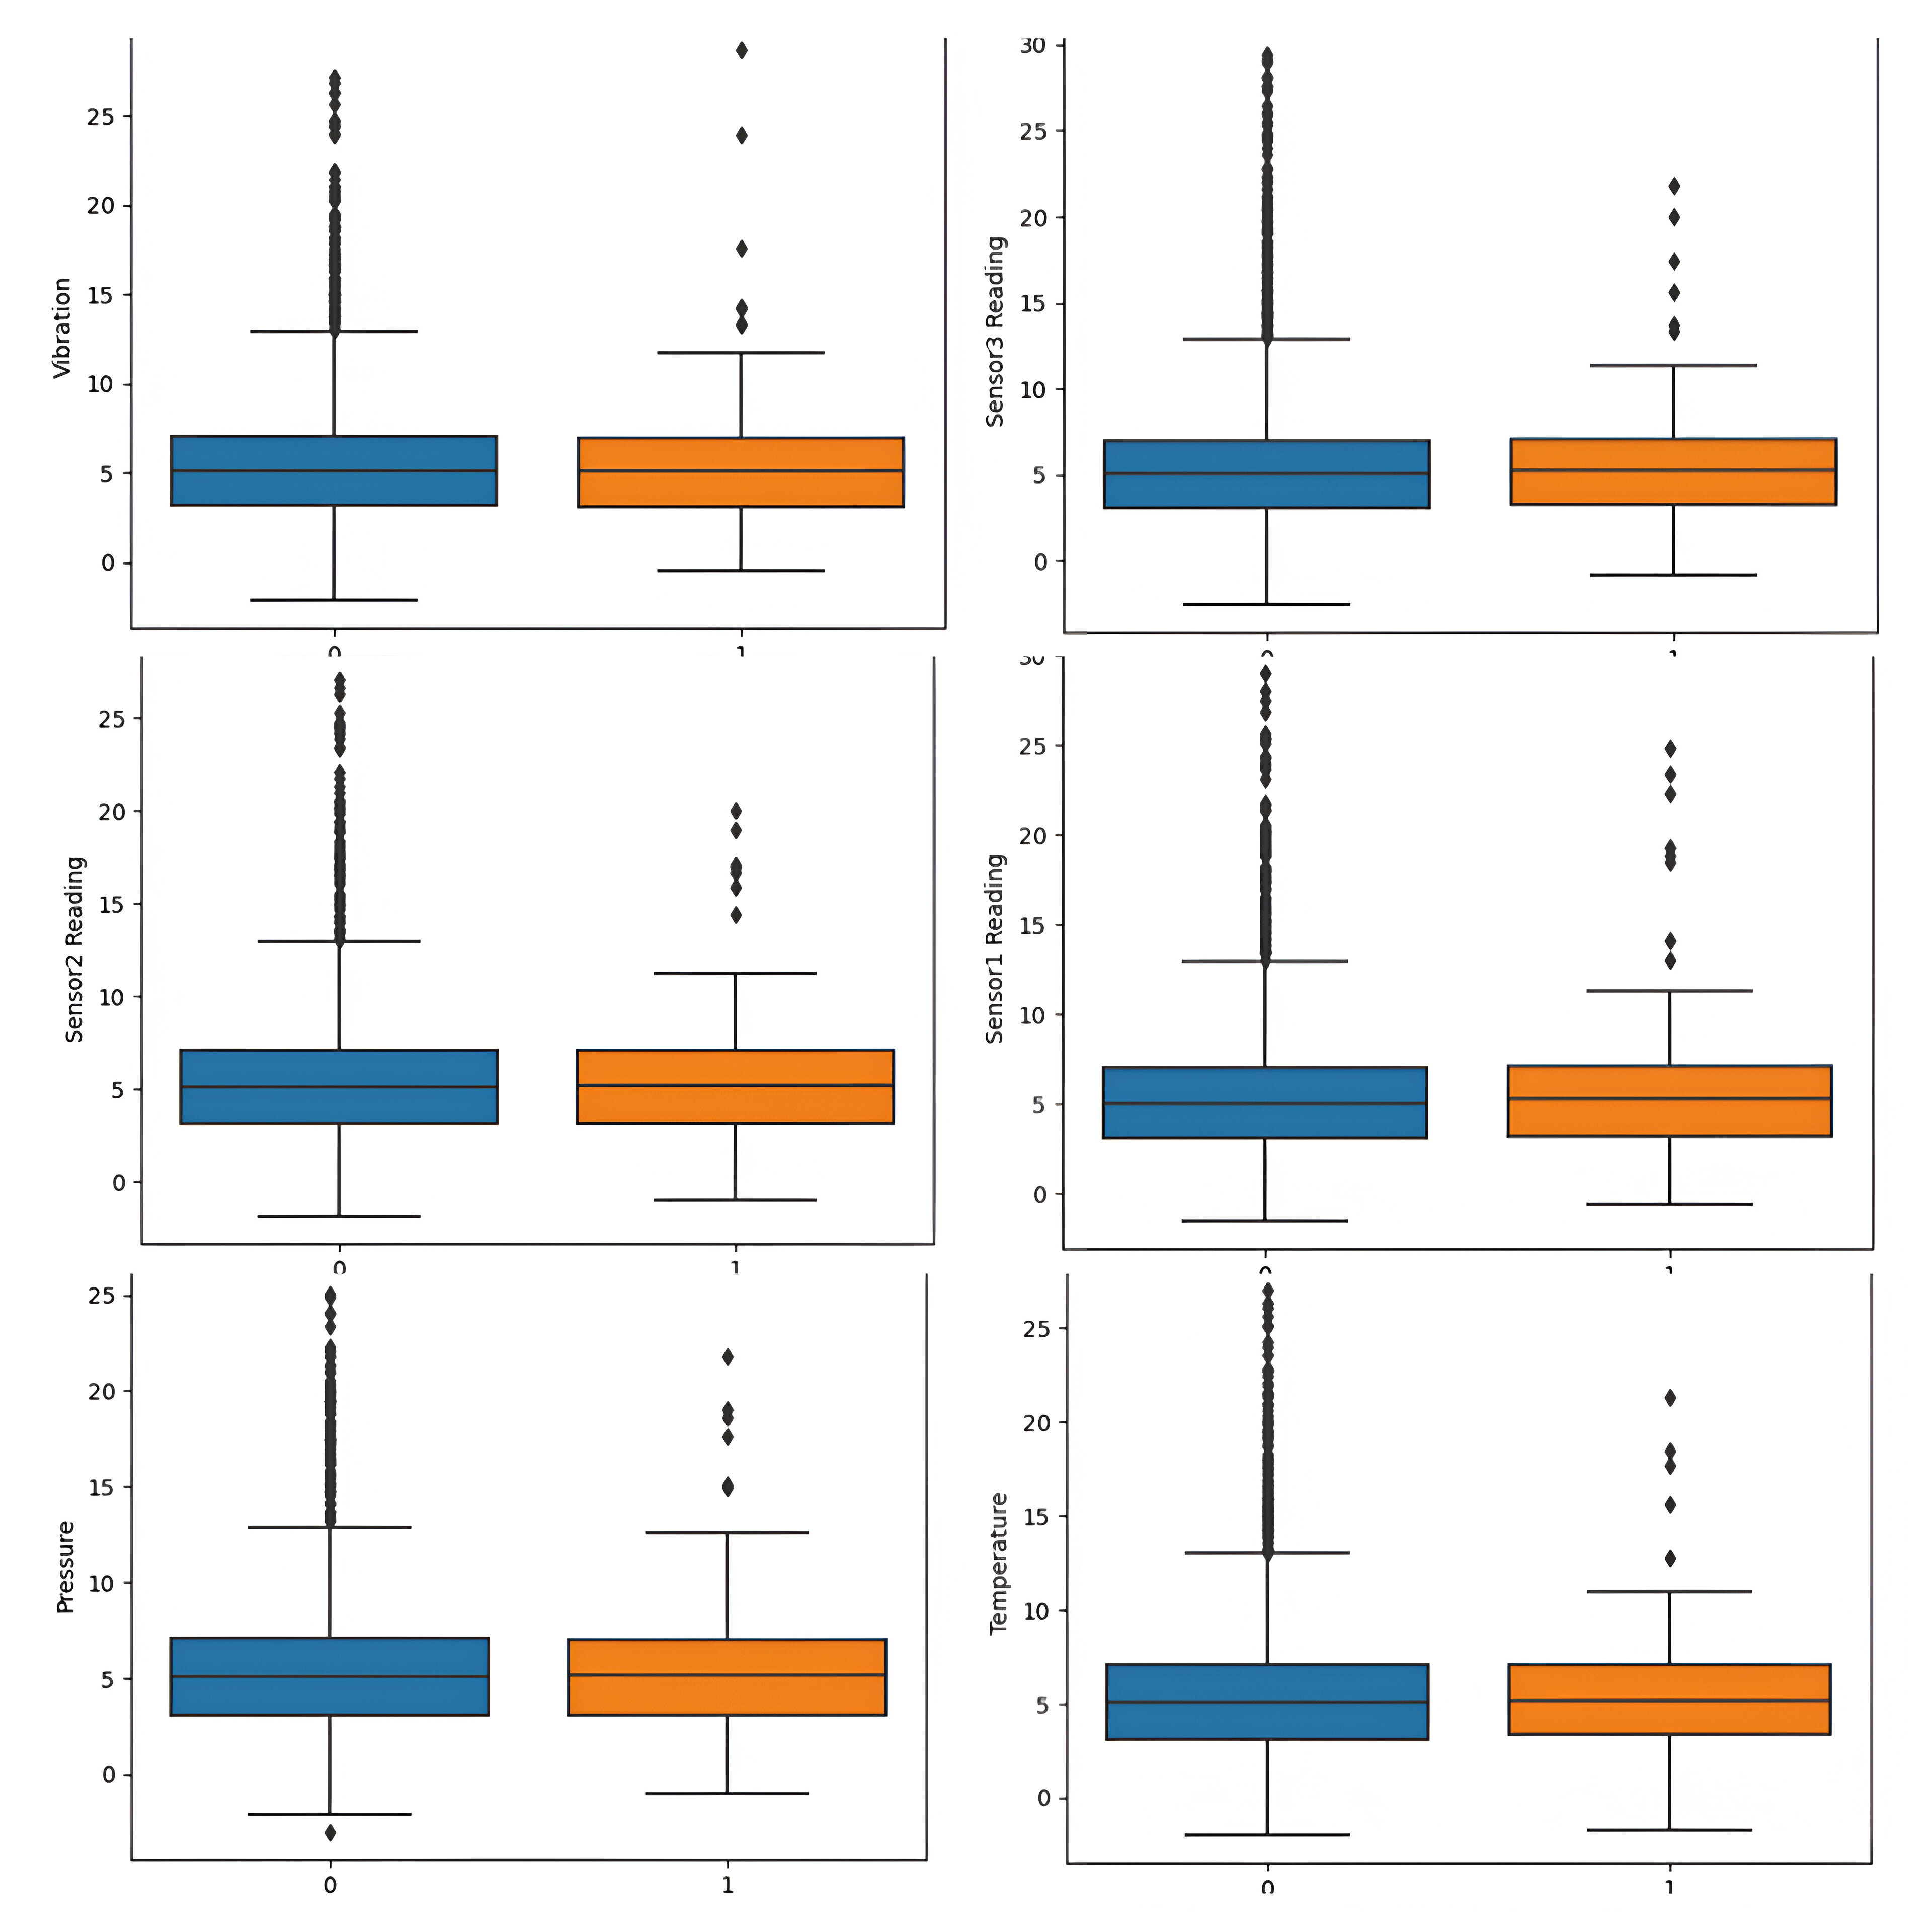
EDA
Box Plots revealing the relationships between Failure Indicator and the following features: Sensor1, Sensor2, Sensor3, Temperature, Pressure and Vibration.

Slide 9
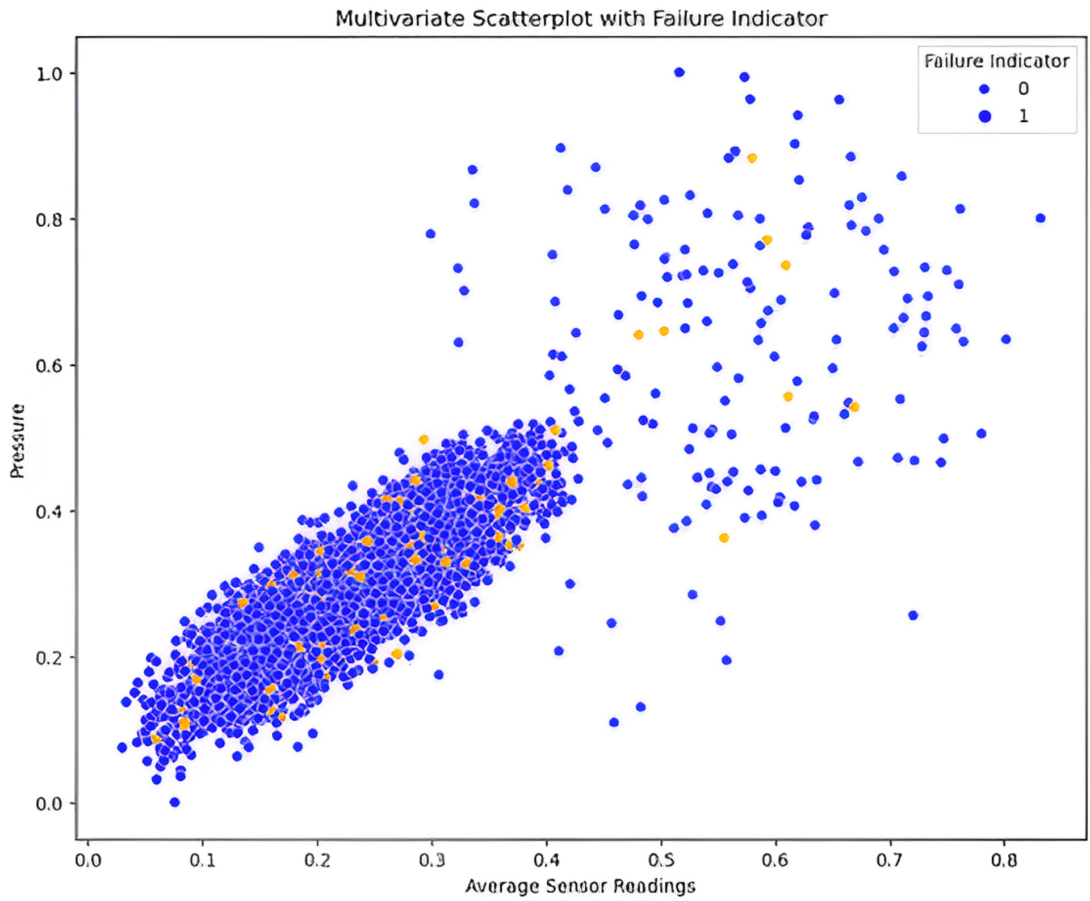
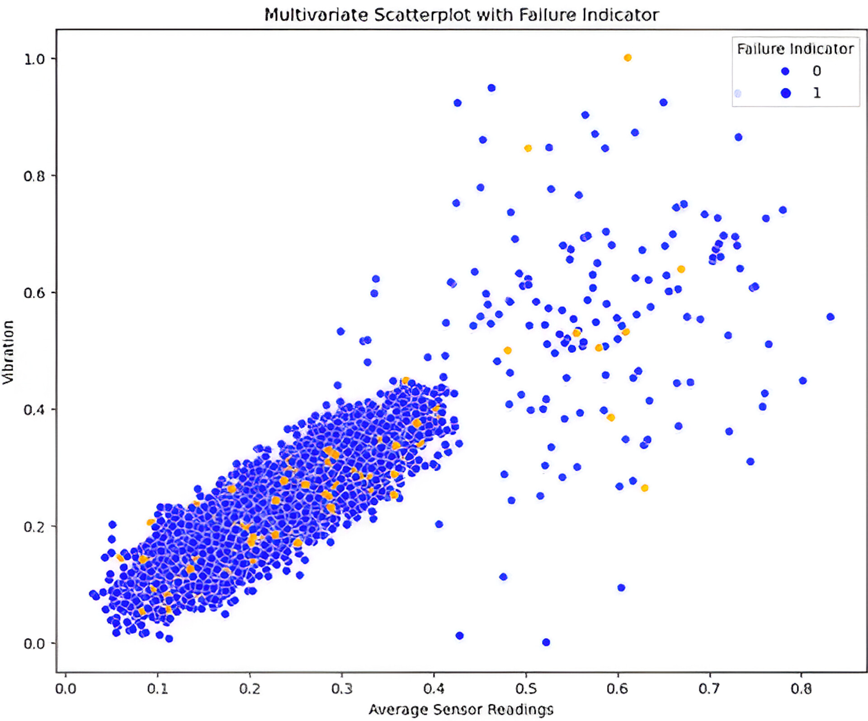
Comparing The Sensor Readings with Pressure, Vibration & Temperature by The Failure Indicator
Pressure vs Average Sensor Reading
Vibration vs Average Sensor Reading

Slide 10
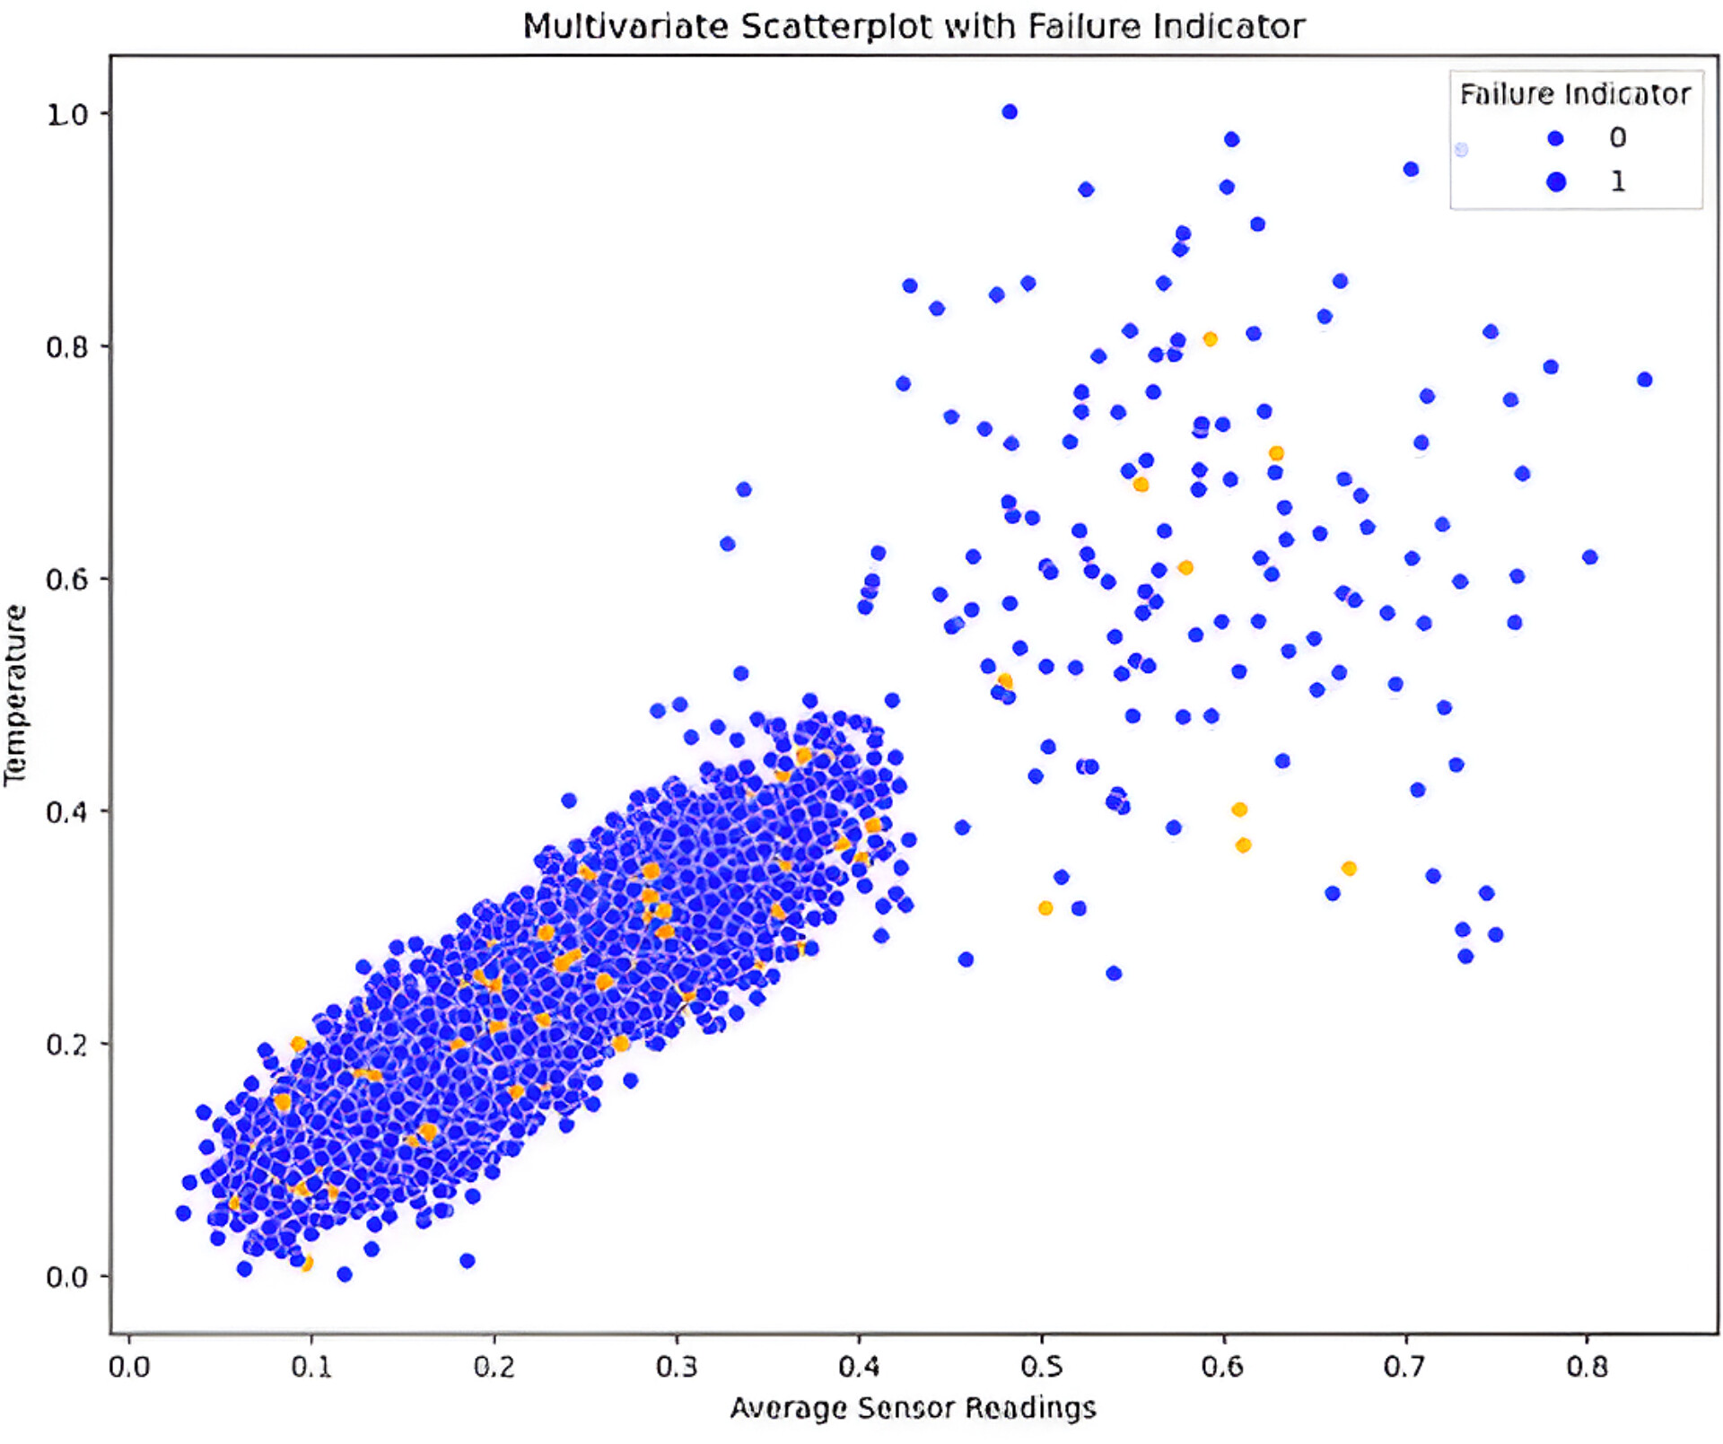
Temperature vs Average Sensor Reading
Observations
Both the box plots and the scatter plots do not reveal clear clusters or patterns indicating specific levels of pressure, vibration, or temperature leading to machine failure, it suggests that there may not be a straightforward linear relationship between these variables and the failure indicator.

Slide 11
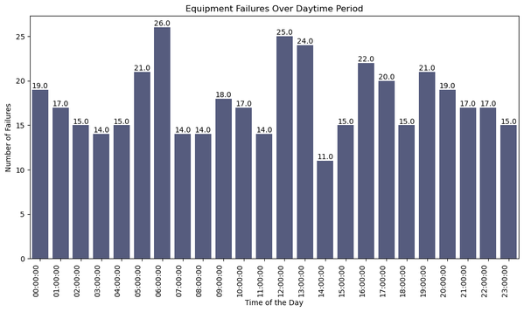
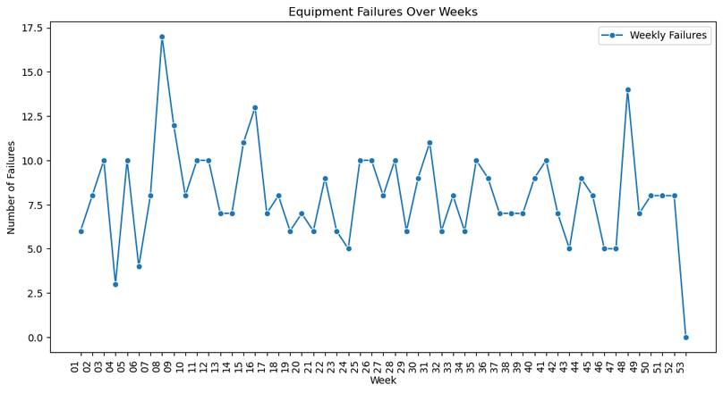
FINDINGS FROM DATA EXPLORATION
TIME IN THE DAY WHEN FAILURE OCCUR
Sum of hourly failure over time
5%
System failure recorded
0-10
Machine Reading when failure occur
WEEKLY MACHINE FAILURE
line chart featuring weekly failure
8
Average weekly failure

Slide 12
Machine Learning (Leveraging Advanced Analytics for Proactive Equipment Management Through Predictive Maintenance)
Predictive maintenance is an advanced approach that employs machine learning algorithms to analyze equipment data and predict potential failures before they occur.
Unlike the visuals that could not reveal a linear relationship between the features of the dataset, Machine learning offers more advanced techniques for detecting patterns and relationships that are non-linear.
Predictive maintenance, powered by machine learning, emerges as a strategic tool for organizations aiming to enhance equipment reliability, reduce costs, and elevate overall operational efficiency.

Slide 13
Importance of Predictive Maintenance:
Minimizes Unexpected Downtime
Reduces Maintenance Costs
Enhances Operational Efficiency
Benefits of Machine Learning in Predictive Maintenance:
Early Fault Detection
Data-Driven Decision-Making
Adaptability to Varied Equipment
Challenges Addressed by Predictive Maintenance:
Shifts maintenance strategies from reactive, post-failure responses to proactive, preventive measures.
Allocates resources efficiently by prioritizing maintenance tasks based on predicted criticality.
Identifies and addresses issues before they escalate, contributing to longer equipment lifespan.

Slide 14
Interpretation of Model Metrics
a. Accuracy
Explanation: Accuracy represents the overall correctness of the model's predictions.
Implication: Our Random Forest model is 94.44% accurate in identifying both positive and negative instances.
b. Precision
Explanation: Precision measures the accuracy of positive predictions.
Implication: 93.6% of the predicted positive instances are correct, minimizing false positives.
c. Recall
Explanation: Recall measures the ability to capture actual positive instances.
Implication: The model successfully identifies 95.4% of actual positive instances, reducing false negatives.
d. F1-score
Explanation: F1-score balances precision and recall.
Implication: Achieving 94.49% F1-score indicates a good trade-off between precision and recall.
e. AUC-ROC
Explanation: Area Under the Receiver Operating Characteristic Curve (AUC-ROC) evaluates the model's discrimination ability.
Implication: An AUC-ROC of 94.44% signifies a strong model performance.
Selected Model – Random Forest
Accuracy: ['94.44%']
Precision: ['93.6%']
Recall: [‘95.4%']
F1-score: [‘94.49%']
AUC-ROC: [‘94.44%']

Slide 15
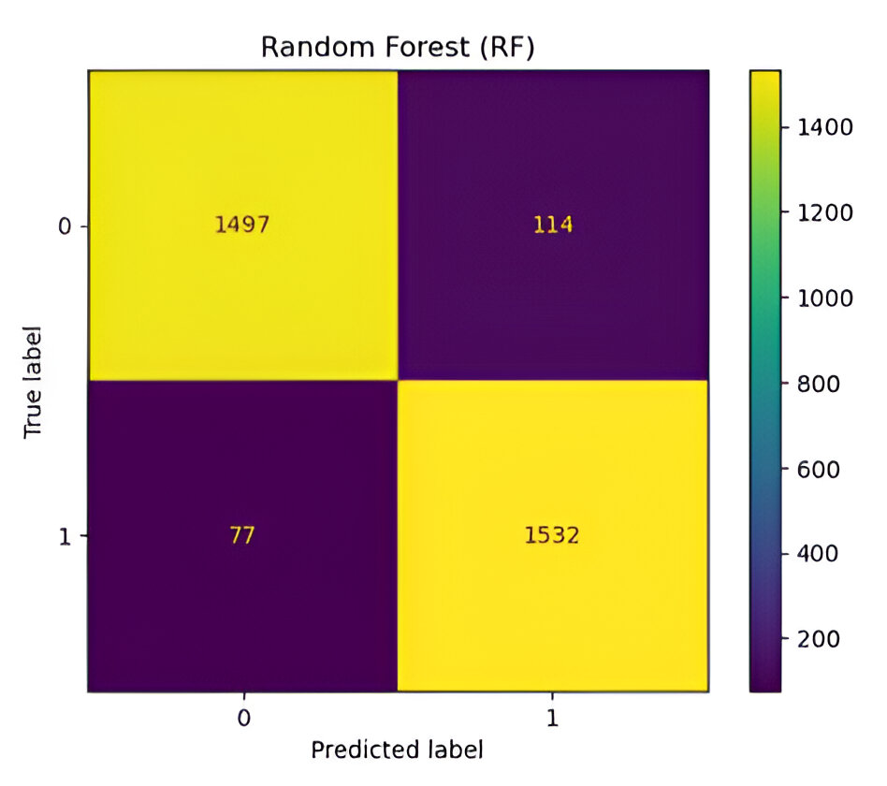
Confusion Matrix
True Positives (1532): Instances where the model correctly predicts equipment failures.
True Negatives (1497): Instances where the model correctly predicts non-failure situations.
False Positives (114): Instances where the model wrongly predicts failures, leading to unnecessary maintenance.
False Negatives (77): Instances where the model fails to predict actual equipment failures, risking unexpected downtime.

Slide 16
Possible Solutions
Data Requirement:
In order to improve failure accuracy, it is essential to provide more detailed information on machine usage.
Addressing Missing Failures:
Given the identification of 425 missing failures over the one-year period, it is advisable for the organization to implement a readily available maintenance staff code. This will ensure timely responses to predicted failures, contributing to enhanced operational reliability. It is imperative not to overlook the significance of investing in machine learning for predictive maintenance.
Interpreting the Confusion Matrix:
Analyzing the confusion matrix reveals 114 instances where our model incorrectly predicts failures. However, it also highlights 1532 instances where it accurately predicts equipment failures. Recognizing the high cost associated with each failure, evaluating the frequency of accurate predictions underscores the potential for substantial savings. Transitioning from reactive to proactive maintenance strategies, informed by our predictive model, could mitigate losses and enhance overall efficiency.
Implementing Real-Time Monitoring In Anticipation of Failure:
Since high failures were observed in the start and ending of the year, routine checks should be more frequent during this period.
Also adequate backup service must be provided in the early our of the day and night time during this period.
Cost-Benefit Analysis of Predictive Maintenance:
Perform a comprehensive cost-benefit analysis to quantify the financial implications of the predictive maintenance approach. Evaluate the cost savings achieved through accurate predictions against the expenses associated with model implementation and maintenance. This analysis can provide a clear understanding of the return on investment and guide decision-making on further improvements or expansions of the predictive maintenance program.

Slide 17

Conclusion
Predictive maintenance offers a strategic solution to the challenges faced by energy companies in managing equipment failures and optimizing maintenance practices. By leveraging advanced analytics and machine learning techniques, our company can enhance operational efficiency, minimize downtime, and ensure sustainable and cost-effective energy generation. Through rigorous data analysis, model development, and seamless integration into operational workflows, we can achieve significant improvements in equipment reliability and maintenance planning.

Slide 18

TEAM MATES
Adenike Ejibunu
Mathias Arogundade
Chinweuba Amu
Mahmud Nyako
Bukola Adenuga
Chigozirim Wali

